Slide 1
Creating Meaningful Writing & Learning Communities
“Somebody’s Pet Project”?
Kerri Bright Flinchbaugh

Slide 2
WLCs as PLCs
Professional Learning Communities core values contend that
Professional development (PD) is critical to improve student learning
PD is most effective when it’s collaborative and collegial
This collaborative work should involve inquiry and problem solving in authentic contexts of daily teaching practices
(Servage, 2008)
Notes:
(Laura Servage, 2008 “Critical and Transformative Practices in PLCs” Teacher Education Quarterly)
Promote two ideals: 1. democratic schools and 2. schools (relationally bound communities
PLCs promote democratic ideal through
- distributed leadership
- shared decision making
- emphasis on dialogue
Such collaborative teacher learning and community are commonly built in
- collective responsibility for student learning
- shared norms (vision or mission)
- mutual regard and caring
- institutional values
- identity of belonging (attempt to relieve alienation)
This model is commonly used to benefit collective work and share responsibility and as a powerful way to meet relationship needs.
“When we learn together as a community toward a shared purpose, we are creating an environment in which we feel congruence and worth.” (Lambert, 2003, pg. 4 - Leadership capacity for lasting school improvement)
PLCs aim/hope to create(Zmuda, Kuklis, & Klien, 2004)
Significant shifts in the cultural and thinking of schools
Share work and critically examine practice with others as trusted members of school community and always against the standards of excellence defined by the shared vision
(Professional learning communities at work: Best practices for enhancing student achievement)

Slide 3
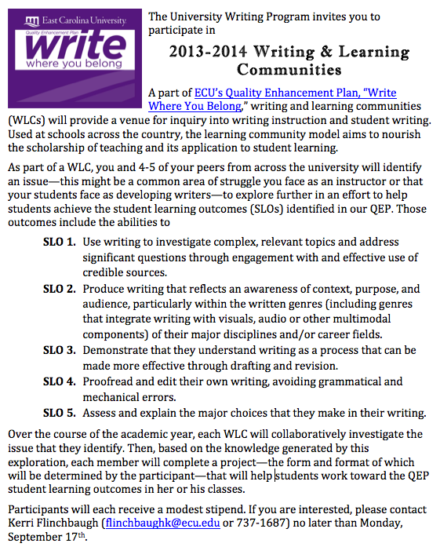
Notes:
Intensions – flexible space for collaborative inquiry into writing instruction and student writing; nourish scholarship of teaching and its application to student learning.
2 groups
Group 1: Writing and critical thinking
6participants (2 English, Finance, Interior Design & Merch, Poli Sci., Bio Ethics
Facilitator – bioethics
Group 2: Writing as a Process
8 participants (Education, Theater & Dance, Psychology, 3 English, Computer Science, History)
Facilitator - English
Supply funds
Timeline – scaffold process of collaboration including activitie. For example,
11/11: topic selection and list of desired resources
11/25: source collection and participant responsibility
1/20: status report of how research is going, how far along people are with reading/sharing
2/17: description of projects each member is working on and list of additional resources desired
3/17: status report
mid-late April: presentations/sharing with ECU community
Facilitators: experienced instructors, participants in other UWP PD, communication between group and UWP, guide group on productive path…
Wendy and I offered services/support (like scheduling space for meetings, creating digital spaces for groups, and providing ideas for scholarship) but tried to step back and le them lead after initial meeting. We had regular ‘check-ins’ with facilitators.
Heuristic
Components of Writing & Learning Communities
Mission and Purpose
Goals for the institution (What do you want the WLC to accomplish?)
Objectives for each WLC (How do you plan to bring about the above goals through specific objectives for each WLC?)
Curriculum
What issues and topic to address within each WLC
Meetings and Activities
Seminars – length, frequency, topics
Conferences – getting away; learning from and sharing with others
Social amenities and gatherings
Scholarly Process
The literature – articles, focus book
Individual teaching projects or other projects
Presentations, both on campus and at conferences – by individual members of the WLC and the entire group
Course or project miniportfolio – prepared by each WLC member for her focus course or project
The scholarship of teaching and learning
Budget
With a total of $400 for your group, how will you budget your money?
Include everything you may need in your list, and place asterisks by the items that are your highest priorities
Group products
Part of WAC PD series and accessible online

Slide 4
2013-2014 WLCs Survey Results
Why did you decide to participate in a WLC?
[interdisciplinary] collaboration (4)
increase skills/knowledge (6)
Amount of structure
Same (7), more (3) – no ‘less’
Facilitator role
Scaffolding
Use of examples
Overall experience
Most interesting/useful aspect
Collaborative process (9)
Product (1)
Notes:
11 of the 14 participants completed
Open coding of qualitative data → overall, positive but room to improve revealed throughout.
Why did you participate
Ex 1: I wanted to network with faculty in other areas, and I was curious to see if others shared my same concerns about student writing. I also knew that hearing their writing concerns would help me to be a better teacher of writing.
Ex 2: I am working to improve my ability to teach students how to write, research, and analyze to the standards of our discipline. It was not something I was ever "taught." I learned by doing and through writing and revising. I feel I owe it to my students to get better at it! I am also striving to be a more constructive grader of student writing.
Amt of stucture:
Ex 1: This struck a good balance of management and freedom. We were able to explore the themes selected by our group as we felt appropriate to our creativity and discipline.
Ex 2: The amount of structure was not a problem, but conflicting goals and poor communication were major obstacles.
- Facilitator role:
Ex 1: We had a great group that set reasonable timelines and participated constructively. Our facilitator did an excellent job of striking a balance between keeping us on task and putting too much pressure on our schedules
Ex 2: It wasn't the worst committee experience I've ever had because all of the people were very nice. teacher-dogma instead of finding out what we wanted to learn to be better instructors of writing.
- scaffolding:
Ex 1: I would love to try this again with a more explicit focus on teacher inquiry and the role of inquiry in university teaching… I will also suggests *What the Best College Teachers Do* as a common read, and that might be helpful as well.
Ex 2: I think group leaders should work together with QEP reps to design "syllabi" similar to what Kerri puts together for WAC academy, and potential participants should review those docs, suggest changes, additions, and deletions, etc. and commit to participating in a leader-facilitated but co-created WLC experience. Perhaps you could survey potential participants ahead of time to find out what kinds of issues/ topics they are interested in and connect WLC participants and leaders with similar interests.
Use of examples:
Ex 1: It would be nice / appropriate to have this year's WLCs present their project to next year's at some sort of kick-off meeting. We didn't know much what we were going to do at the beginning. Giving them a few examples up front might help them get the creative juices flowing.
Most interesting/useful aspect
Ex 1: Exchanging ideas and having dedicated time to think and talk about writing instruction.
Ex 2: Engaging interdisciplinary approaches to encourage student improvement in writing.
Ex 3: The handouts/artifacts that we developed were most useful. They are things that I will use in future classes.
Overall experience
Very good (7)
Good (2)
Very bad (1)
Ex 1: It was a very enjoyable and productive activity. My WLC-mates were fun and full of great ideas. I've created several new assignments and class activities and am already using them in my classes with positive effects.
Ex 2: My expectations were totally off-base, and the purpose of this group was not to improve our teaching of writing. We were just the slave labor needed to complete somebody's pet project. … The meetings were extremely tedious and unproductive when we were supposed to discuss the articles that had little value in the way of practical application. If someone wanted to know the ancient history and philosophical perspectives of this field, maybe they would have felt more enthusiastic. For me, this part of the WLC was a waste of time. Then at the end, instead of developing resources, we were just supposed to produce them. This was a very aggravating experience.

Slide 5
2014-2015 WLC Revisions
Reflecting on participant feedback…
Role of facilitator
Scaffolding
Scheduled meetings with timeline
Returning to scholarship…
PLCs
Transformative PD
Notes:
Facilitator and scaffolding
Ex 1: . The facilitator was a great choice for someone who can hold just enough pressure on the reins. We had fun in the meetings, and were productive at the same time. While it obviously involved taking on extra work to participate, he was considerate of our time and provided a lot of encouragement. I recommend him or others like him (though there can't be many!) to serve as facilitators for WLCs of the future.
Ex 2: The facilitator tried very hard to motivate us to study these views about teaching writing and I'm sure she's a great writing instructor, but for this group, the efforts seemed misdirected. There was so much writing-teacher-jargon that much of the time I had little idea what the facilitator was talking about. (Asking questions led to more jargon and longer meetings.) The project seemed like an effort to indoctrinate us in writing-
Wendy and I stepped in as facilitators to try and improve experience and so we will be able to speak to the role and provide better preparation for future faculty facilitators
Attempted to reach out to other, similar/like-minded inquiry groups already establish on campus…
Scaffolding – clearer expectations for final projects while trying to remain flexible, a more detailed timeline, examples of previous groups’ projects
Transformative PD: a social process in which one’s actions are guided by the constructions and appropriations of new or revised interpretations of meaning (Mezirow, 1994).
(Understanding transformation theory. Adult Education Quarterly, 44, 222-232)
- goal of transformative professional development is to educate instructors in such a way that their thoughts, behaviors, and classroom practices are changed due to their participation in PD in ways that promote student achievement (Mezirow, 1997). For teachers, such learning can be considered effective if what an instructor learns in PD is then applied or used to guide action in their teaching context.
Transformative learning: Theory to practice. New Directions for Adult and Continuing Education 74, 5-12.

Slide 6
Next time…
Determine dedicated time to meet
Continue to revise the final project expectations
Continue to revise the structured schedule
Provide access to more examples

Slide 7
Key Questions
How can we best build and support communities?
How can we best prepared faculty facilitators?
Notes:
Shared purpose is only a partial definition… (Servage, 2008)

